Slide 1
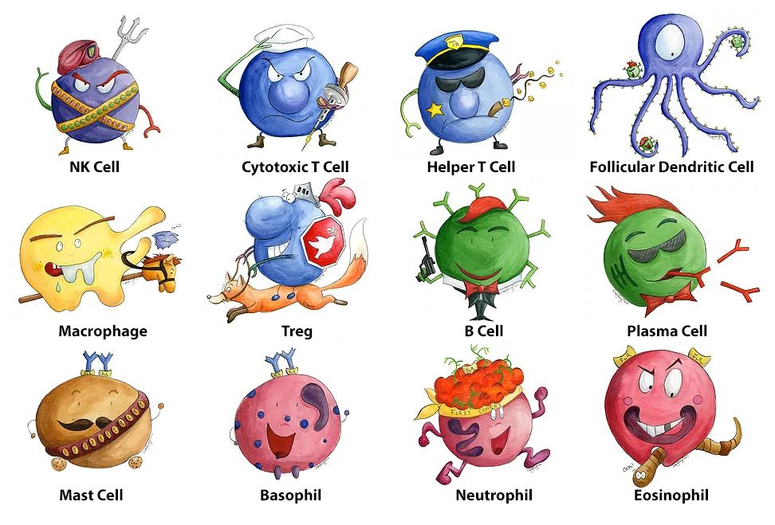
Science of Living System: BS20001
Host Defense and Prevention of Diseases
Ritobrata Goswami
School of Bioscience
Email: ritobrata.goswami@iitkgp.ac.in
Tel: 03222-260518

Slide 2
Human Diseases
Infections (caused by bacteria, virus, fungi etc)
Autoimmune diseases (Failure of our immune system in recognition of self vs non-self)
Immunodeficiency (lack/defect in immune system)
Cancers (several known and unknown reasons)

Slide 3
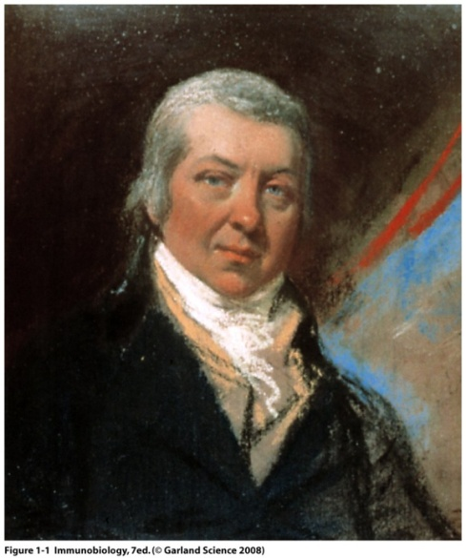
Immunology: The Beginning
In 15th century dried crusts from small pox were either inhaled or inserted into small cuts in the skin (Variolation).
In 1796, Edward Jenner demonstrated that inoculation with cow-pox protects against small pox, a lethal disease at that time. A process he termed Vaccination
Louis Pasteur’s hypothesis: Weakened or attenuated strain could be administered to protect from that specific strain causing disease - Vaccine
Edward Jenner: father of Immunology
Notes:
Dates…

Slide 4

The Immune System: Body’s Defense Mechanism
The main objective is to seek, identify and kill invaders
A complex system that encompasses every organ and compartment of the body
Highly adaptable (can act against pathogens ranging from ~ 30nm to ~100 cm)
Distinguishes between self and foreign and mount response to only foreign while preserving self (‘us’ vs ‘them’)

Slide 5
Challenges of the Immune System
Pathogen-induced diseases:
Autoimmune diseases: When self is attacked by the immune system
Cancer: Failure of Immune system to attack defective cells
Immune deficiency: A component of immune system is absent/defective

Slide 6
Our immune system generates almost infinite variety of cells and substances
Foreign Recognition
Effector Response
Memory
To eliminate or neutralize foreign particle
Upon second exposure produces enhanced response
Active immunity: Immunity that will generate long term memory
Passive immunity: Immunity that will generate short term memory
when a person becomes infected by a disease, the body builds immunity against the disease (natural)
a person can build a resistance to a disease following vaccination (artificial)
when an infant receives mother's antibodies (natural)
when a person receives antibodies (gamma globulin injection), say after a snake bite (artificial)

Slide 7
The immune system
A functional system – NOT an organ system:
A very complex system that includes:
Skin – physical barrier
Lining of mucus membranes – physical barrier
Secretions – tears, mucus etc - antimicrobial
Blood cells and vasculature – White blood cells (WBCs)
Bone marrow—source of Hematopoietic Stem Cell (HSC)
Lymphatic system and lymphoid organs
Most tissues – have resident immune cells

Slide 8
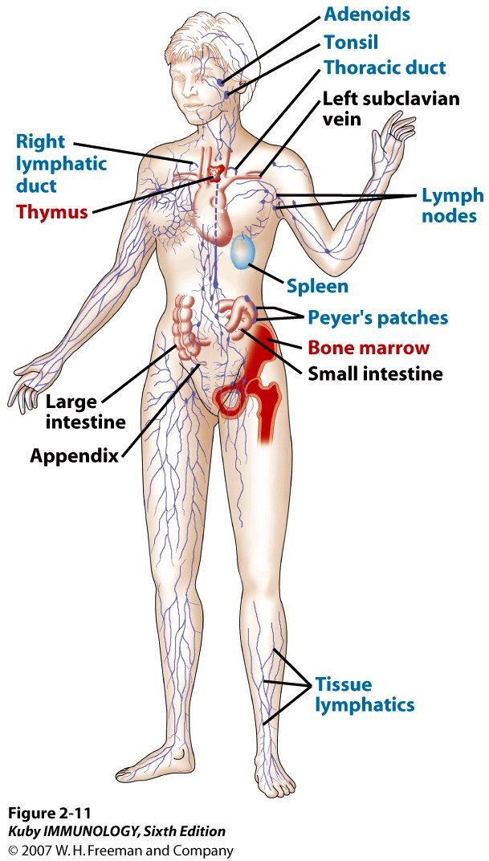
Distribution of the Immune System
Red: Primary lymphoid organs
Blue: Secondary lymphoid organs
T cells are matured in the thymus
The bone marrow contains
blood-forming Stem cells,
and makes B cells, innate
cells, and all other blood
cell types

Slide 9
Two modes of immunity
In response to pathogens, vertebrate immune systems use two interconnected systems:
Innate immunity: inborn
Adaptive immunity: acquired during the life-span

Slide 10
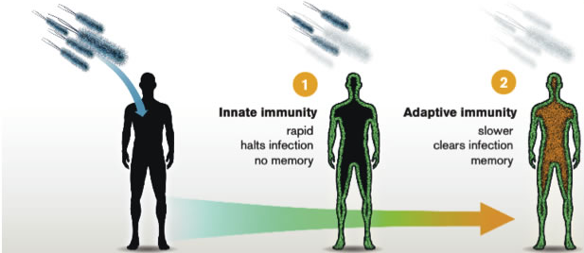
Innate vs Adaptive Immunity
Innate Immunity
Rapid
Halts Infection
No Memory
Adaptive Immunity
Slower
Clears Infection
Memory

Slide 11
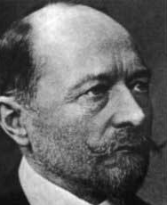
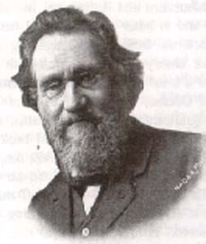
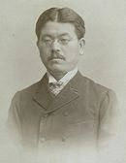
First insights into mechanisms of immunity
Emil von Behring
1880’s- Metchnikoff discovered phagocytic cells that ingest microbes and particles-
cells confer immunity
1890- von Behring and Kitasato discovered blood sera could transfer immunity-
liquid of blood confer immunity
What confers immunity…
cells or serum?
Elie Metchnikoff
S. Kitasato

Slide 12
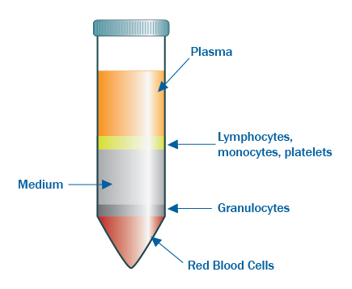
Components of immune system in Blood
Centrifugation of blood
Immune component
Antibodies and others
WBCs

Slide 13
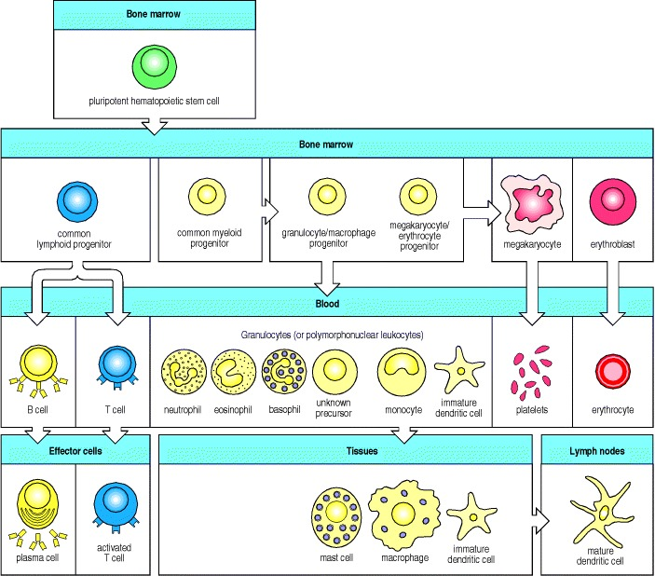
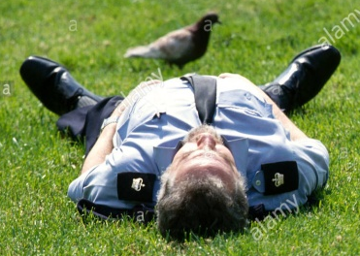
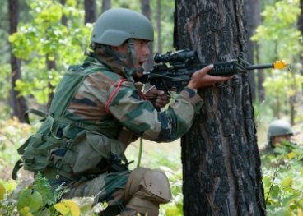
Blood cell types and their origin

Slide 14
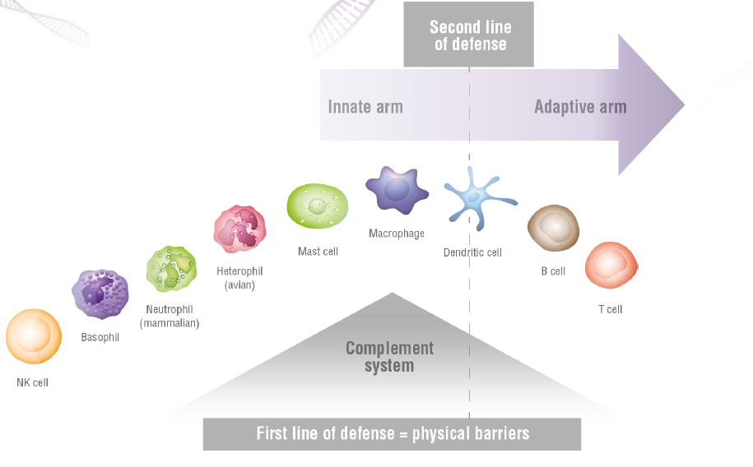
Immune system defends against infection

Slide 15
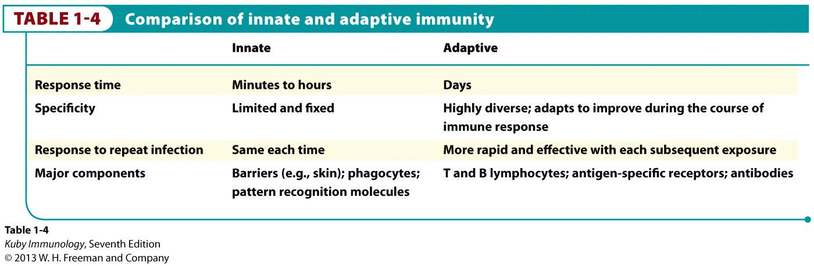
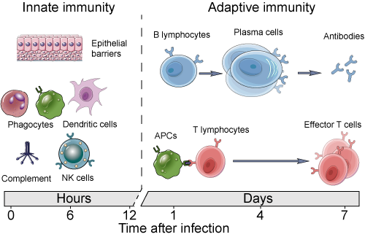
Innate vs Adaptive : Differences at a glance

Slide 16
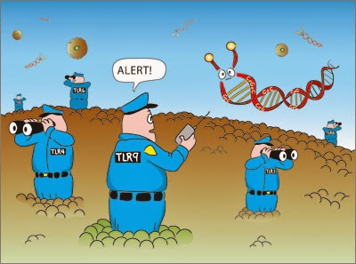
Innate immune system
http://sciencebyadam.blogspot.in/

Slide 17
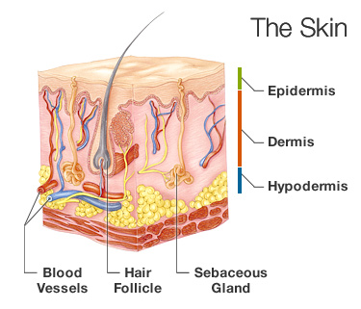
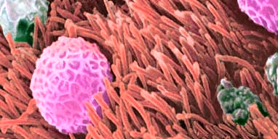
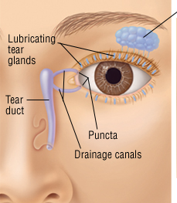
Mechanical Factors
Skin
Mucous
Flushing action of saliva, tear, urine

Slide 18
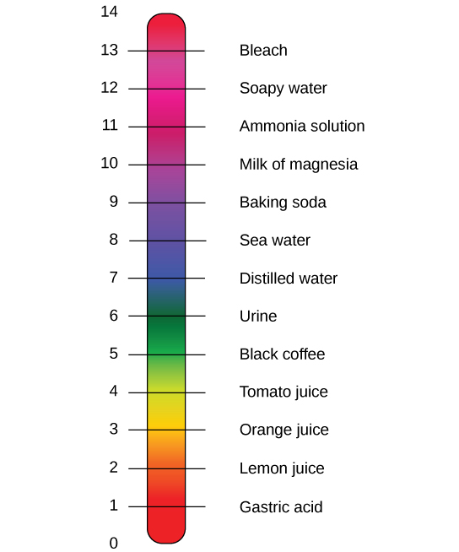
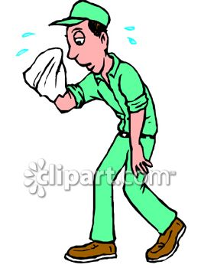
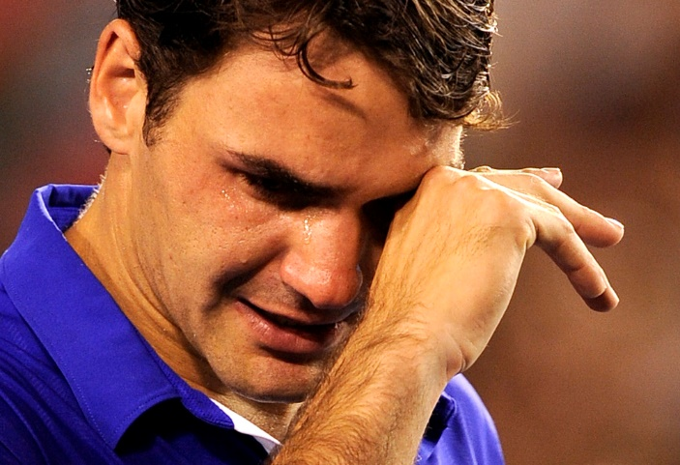
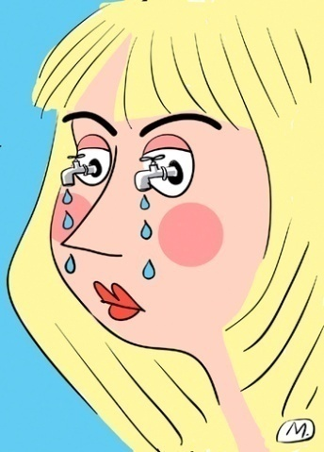
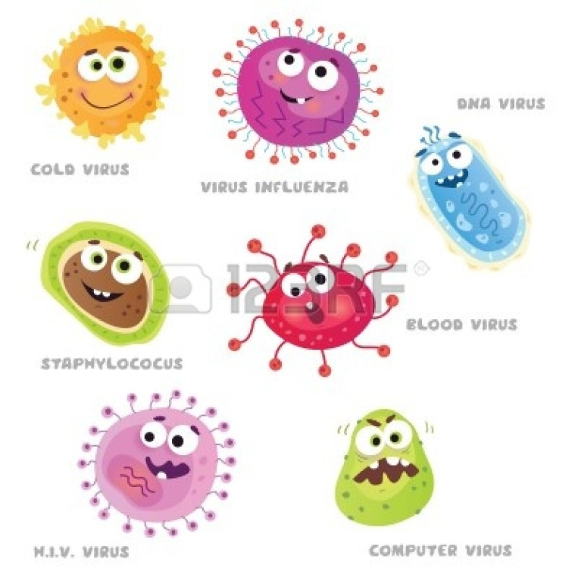
Chemical factors
Antimicrobial Peptides in sweat
HCl in stomach
Lysozyme in tears /saliva
Notes:
Sweat – AMP – dermcidin

Slide 19
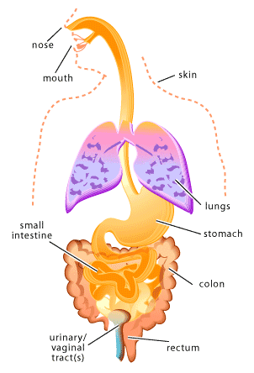
Biological factors
Symbiotic (commensal) microbial flora:
microbes in many parts of the body
> 1000 species of bacteria
competes with pathogens for nutrients and space

Slide 20
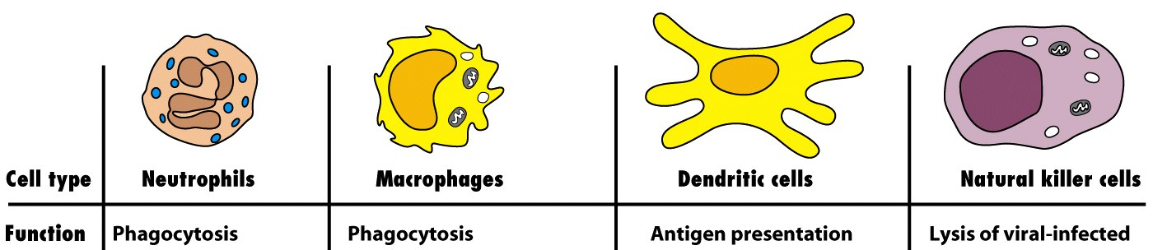
The Major Cells of Innate Immunity
Big eaters/Always hungry
Antigen presentation
Phagocytosis
Antigen Presenting Cells (APCs)
Proteins eaten by APCs are broken down to small pieces (peptides), which are loaded on special receptors (MHCs) and transported to the cell surface. Peptides loaded MHC complex can be recognized by T cells and that interaction can lead to adaptive immune response.

Slide 21
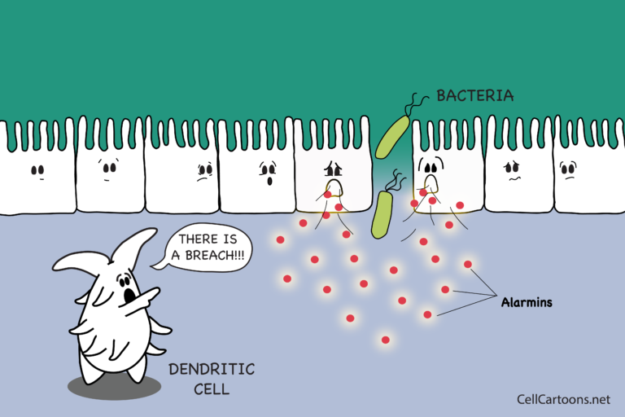

Slide 22
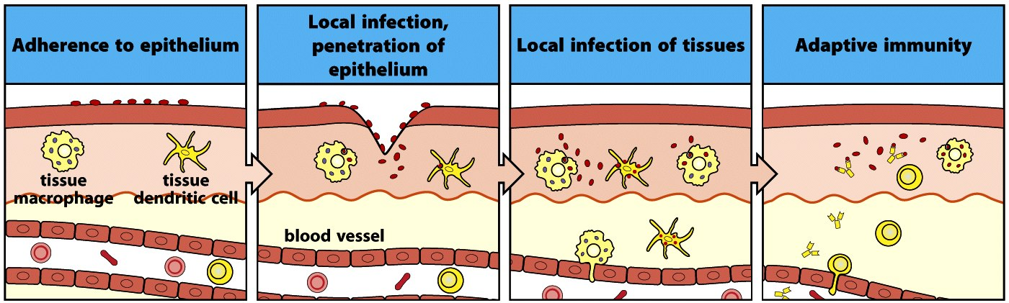
Epithelial Barriers: what happens after a breach?
Innate immunity
Janeway 7th edition

Slide 23
Epithelial Barriers: what happens after a breach?
Inflammatory response: A fundamental type of response by the body to injury/localize infection is characterized by the classical signs of :
Increase in blood volume in the area
1. Vasodilation
Heat and Redness
2. Vascular permeability increases
Leakage of fluid from blood vessel
Swelling, Pain
Inflammation: Heat, Redness, Swelling, Pain
WBCs enter the tissue from the local blood vessels and halts or clears the potential threat

Slide 24
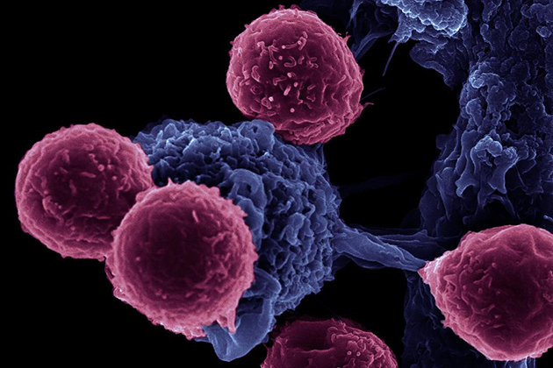
Components and Mechanisms of the Adaptive Immune Response
An image of immune cell communication, showing dendritic cells interacting with T cells, taken using an FEI microscope, magnification 16,000x. (Rita Serda/FEI Image)

Slide 25
Adaptive Immunity: Our most powerful defense
More tuned to subtle molecular differences
Takes more time to develop; antigen specific
Gradual resolution of infection is outcome; depends on B and T cells
Able to better recognize, eliminate, & remember the invading pathogen
Development is dependent upon earlier innate pathways
Adaptive immunity provides a second & more comprehensive line of defense based on the struggles of innate immunity

Slide 26
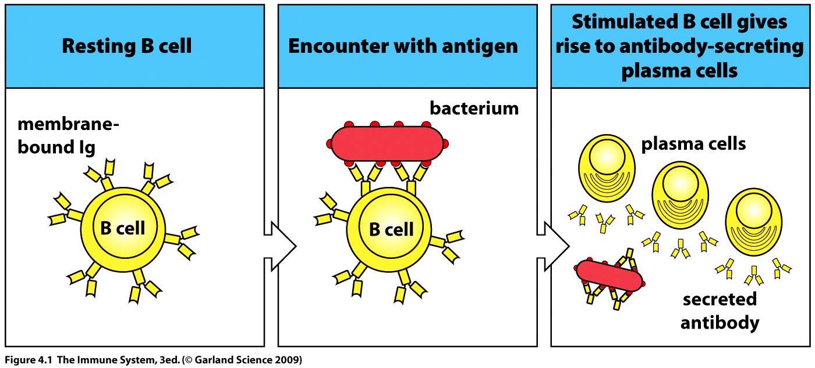
Activation of B Cell and Production of Antibody
Each B cell can recognize only one antigen
That B cell gets activated and differentiated into numerous plasma cells
All of these plasma cells produce same antibody in a very efficient manner
These antibodies are then utilized in the clearing of initial antigen/antigen providing microorganisms, which was initially detected by B cell
Notes:
Figure?

Slide 27
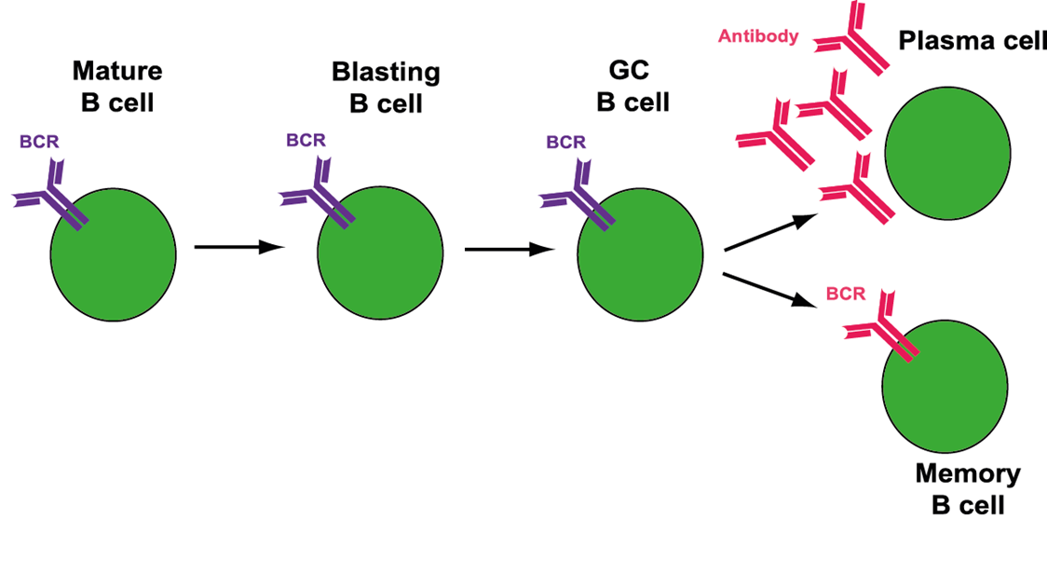
B cell differentiation after activation
Notes:
When a mature B cell encounters antigen that binds to its B cell receptor it becomes activated. It then proliferates and becomes a blasting B cell. These B cells form germinal centres. The germinal centre B cells undergo somatic hypermutation and class switch recombination. Plasma cells and memory B cells with a high-affinity for the original antigen stimuli are produced. These cells are long lived and plasma cells may secrete antibody for weeks after the initial infection.

Slide 28
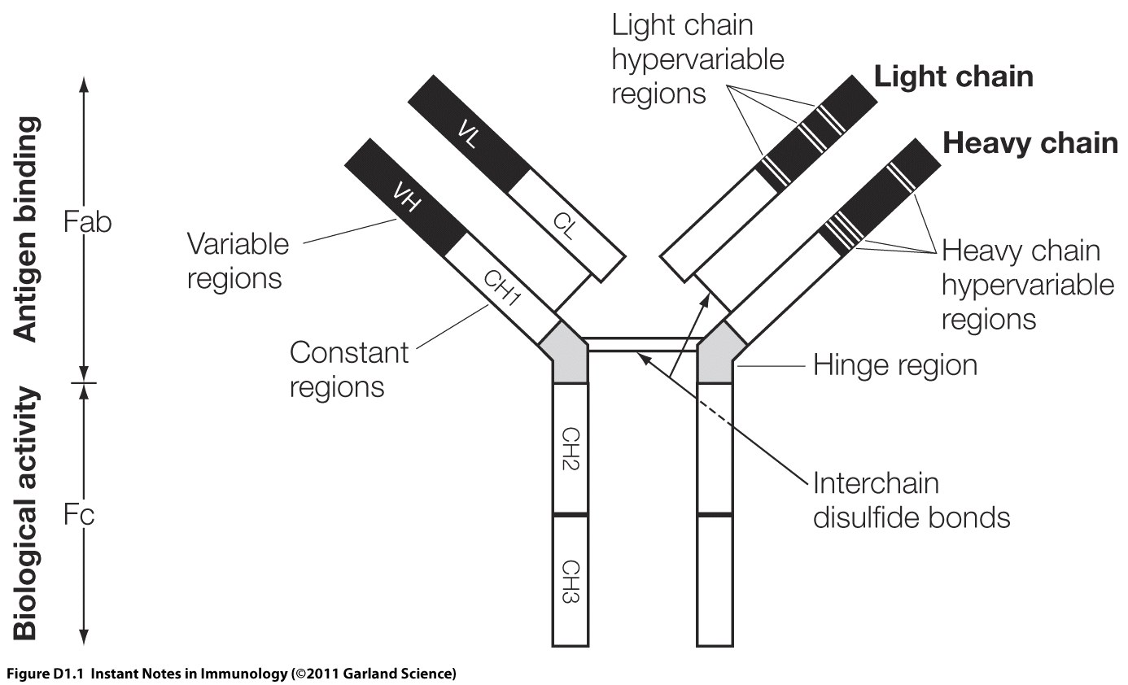
Structure of an Antibody molecule

Slide 29
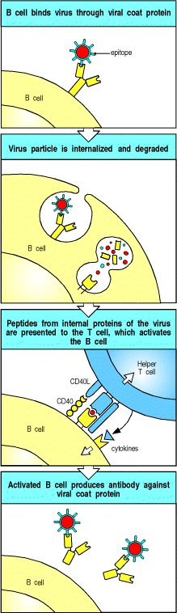
B cells and T cells must recognize epitopes of the same molecular complex in order to interact

Slide 30
Adaptive Immune Response: Role of T cells
Antigen presented by APC (via MHC)
T Cells
Cytotoxic T Cell
Helper T Cell
B Cell
Virus Infected/abnormal cell
(with antigenic peptide loaded on MHC I)
Plasma cell
(antibody producing B cell)
Killing of infected cell
Antibody
Neutralization
Induction of phagocytosis

Slide 31
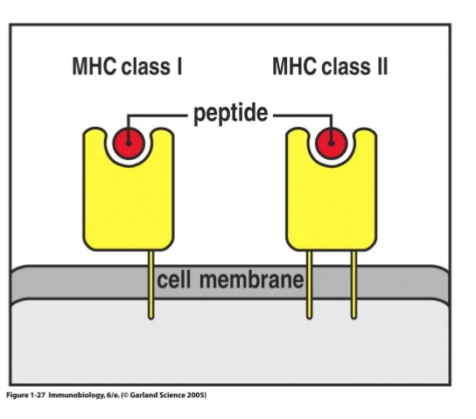
‘Professional’ Antigen Presenting Cells (APCs)
express both MHC class I and class II molecules
Examples of APCs:
Dendritic cells
Macrophages
B cells
Notes:
B cells
Dentritic cells- CD4 and CD8
Macrophage- CD4 only (phagocytosis only)

Slide 32
Adaptive Immune Response: Key Points
Initiated by innate system
Diverse set of receptors
Recognizes pathogen-specific epitopes (immune specificity)
Immune memory

Slide 33
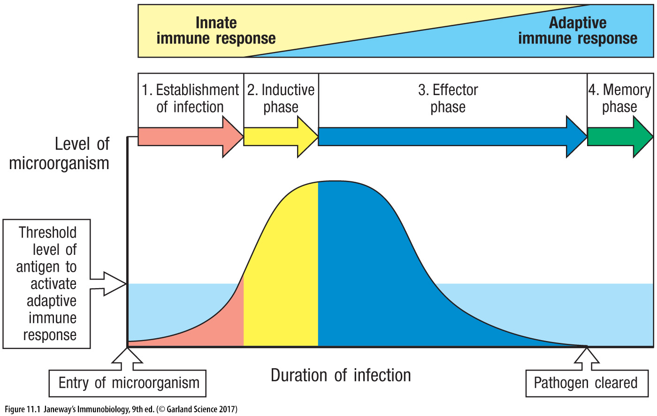
Innate vs Adaptive Timeline after infection

Slide 34
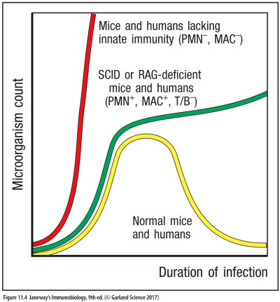
Innate vs Adaptive Which immunity confers more protection?
Losing the Innate arm of the immune system results in more disastrous outcome than losing the acquired arm

Slide 35
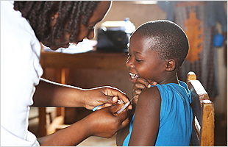
Vaccination (Immunization)
http://www.who.int/campaigns/

Slide 36
Drug vs Vaccine
Concept of Drug
Kill invaders or foreign pathogens
Inhibit the growth of pathogens
Concept of Vaccine
Train immune system to face various existing disease causing agents
Generate memory against specific pathogens

Slide 37
Vaccination: an ongoing global effort
Vaccination has yielded some of the most successful stories in alleviating worldwide mortality rates
The last case of naturally acquired case of small pox was reported in 1977
Consequence of eradication: universal vaccination not required
Most vaccine carry slight risk to the person vaccinated
In many cases every person do not need to be immunized to protect most of the population
Herd immunity: if a critical mass of people acquire protective immunity they can serve as buffer for the rest

Slide 38
Immunological Memory & Vaccination
Natural infections:
1st infection → memory → 2nd infection
slow response fast response
pathogens multiply pathogens disposed
Symptoms/disease no disease
Vaccination → memory → natural infections
no disease fast response
pathogens disposed
no disease
Vaccination protects us from infection by inducing the adaptive immune response, bypassing the need for a natural infection

Slide 39
References
Janeway’s Immunobiology
Kuby’s Immunology
https://www.youtube.com/watch?v=zQGOcOUBi6s

Slide 40
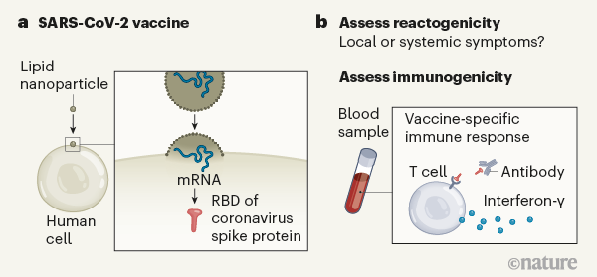
Assessing a vaccine that targets the SARS-CoV-2 coronavirus
Notes:
a, The vaccine contains messenger RNA in a lipid nanoparticle that is taken up by human cells. The mRNA encodes a region of the coronavirus spike protein termed the receptor-binding domain (RBD). b, After vaccination, the authors monitored the trial participants’ responses. One type of response assessed was ‘reactogenicity’ — signs of the body’s reaction to vaccination, such as local swelling at the injection site or systemic effects elsewhere in the body, for example, headache or fever. Another type of response assessed, called immunogenicity, relates to signs of an immune-system defence against the vaccine target, as indicated by the presence of RBD-specific antibodies, and RBD-specific T cells that produce the signalling molecule interferon-γ.

